Slide 1
Salary prediction based on Job descriptions
this project is to examine a set of job postings with salaries and then predict salaries for a new set of job postings.

Slide 2
Data supplied
There are three CSV data files:
1. train_features.csv: Each row represents metadata for an individual job posting.
The “jobId” column represents a unique identifier for the job posting. The remaining columns describe features of the job posting.
2. train_salaries.csv: Each row associates a “jobId” with a “salary”.
3. test_features.csv: Similar to train_features.csv, each row represents metadata for an individual job posting.
The first row of each file contains headers for the columns.

Slide 3
Software languages and libraries used
Python programming language
Google colab for a notebook environment
Pandas
NumPy
Scikit-learn
Seaborn
matplotlib

Slide 4
Steps taken for this project
Part 1: defined the problem
Outlined what are the features, the target variable?
Is it a regression problem or classification? Then decided the metric to optimize.
Part 2: discovered the data
Checked missing, duplicate data, and outliers and summarized the data.
Visualized the features with the target to check their impact and relationship.
Part 3: developed the model
Built linear regression, gradient boosting, and random forest regression model.
Fine-tuned them by hand, and fit them, selected the best one, fit and checked the prediction.

Slide 5
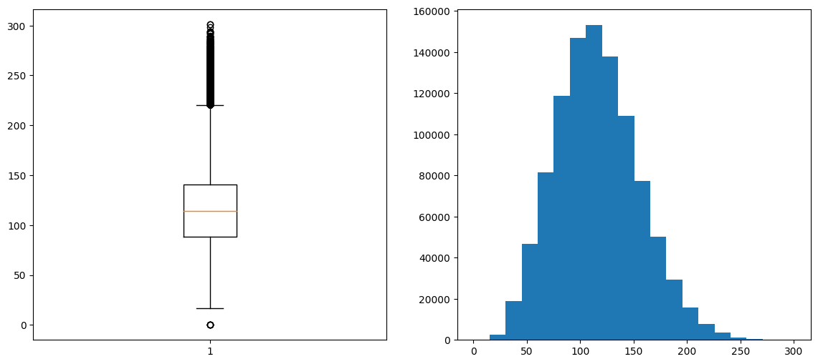
Boxplot denotes outliers which need to be further investigated

Slide 6
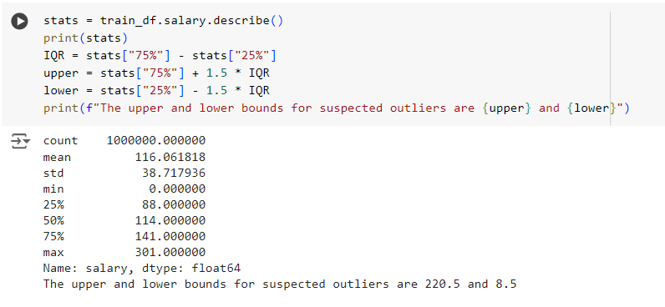
Outliers are below 8.5 and above 220.5

Slide 7
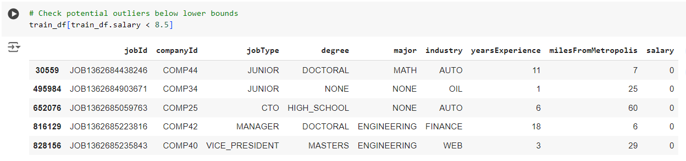
The salary is 0 which looks corrupt data so best to drop these records

Slide 8
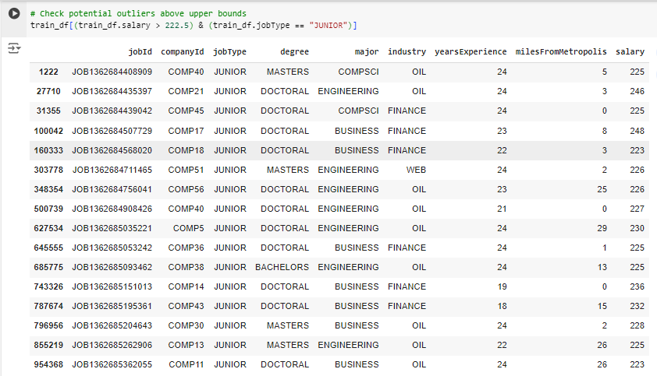
Degree, major, and experience justifies the salary though the job type is junior

Slide 9
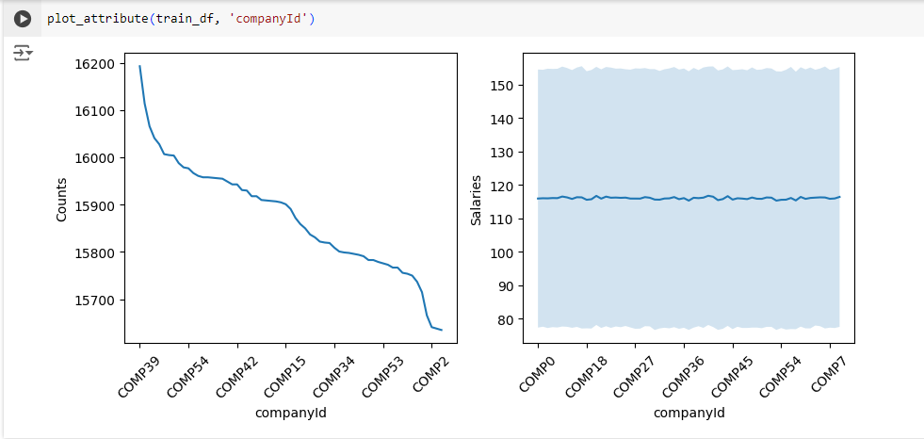
Companyid does not give any insight

Slide 10
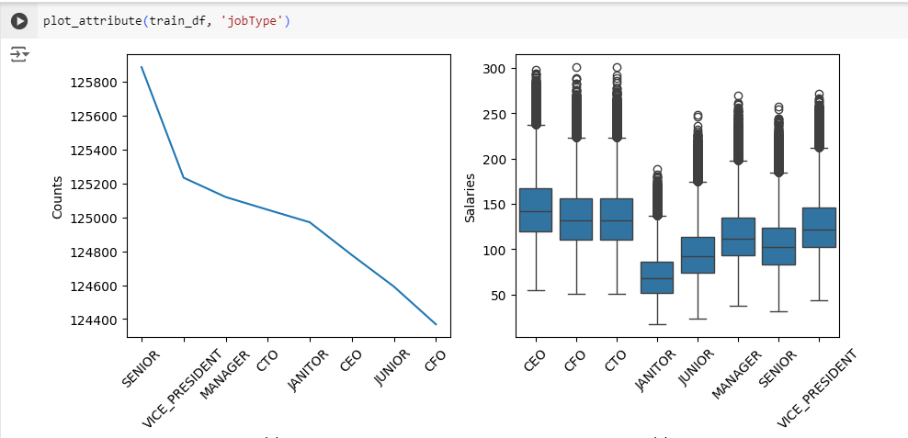
as the level of seniority goes up, the salary increases.

Slide 11
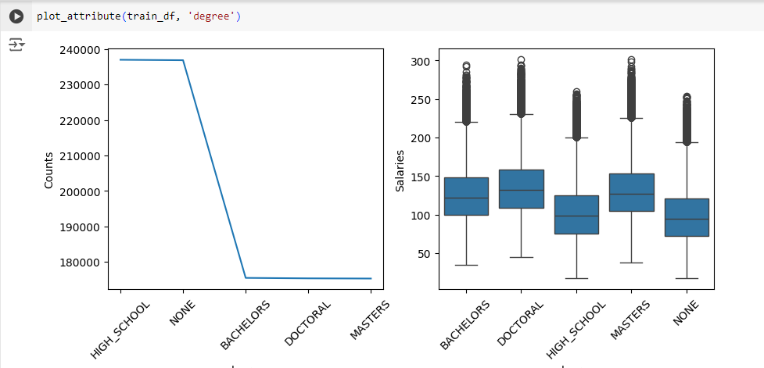
People without degree or with a high school obtain the lower salaries in comparison with people who have bachelors, masters or doctoral.

Slide 12
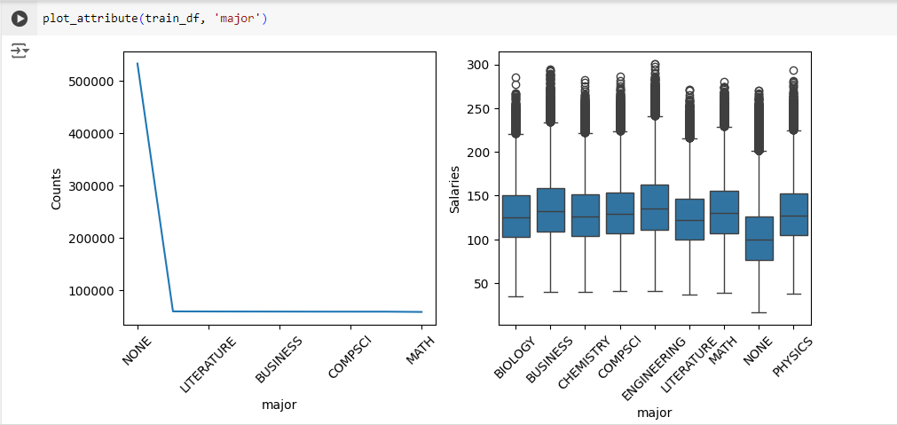
Employees who are major in any subject get nearly same salary. However, those without any major obtain 20% lower wages than their peers.

Slide 13
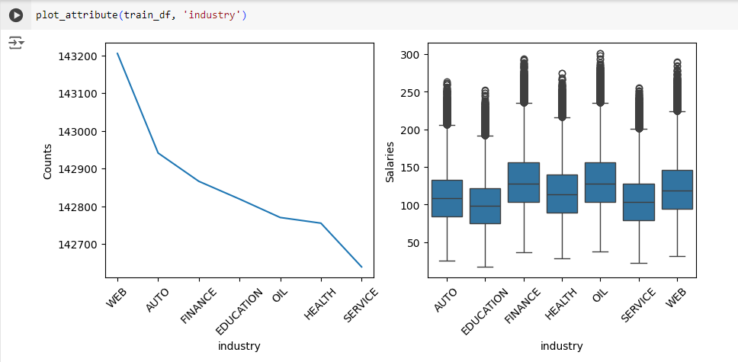
The highest wages are paid in Oil and Finance, whereas Education sector pays the lowest.

Slide 14
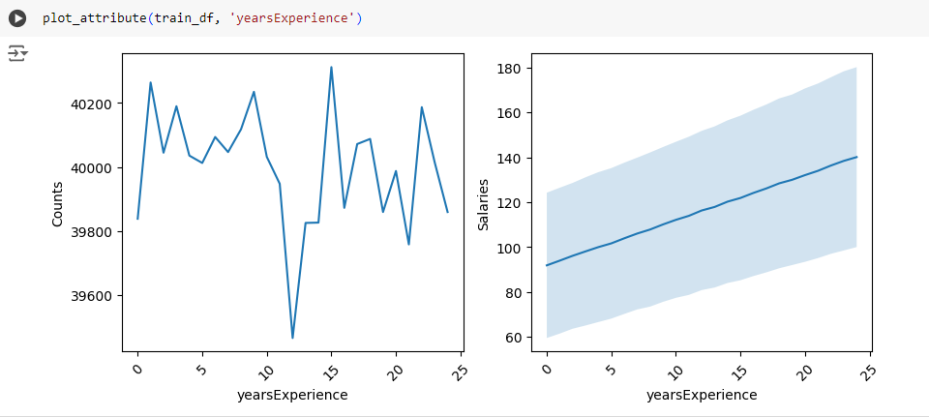
as experience increases, the amount of salary goes up.

Slide 15
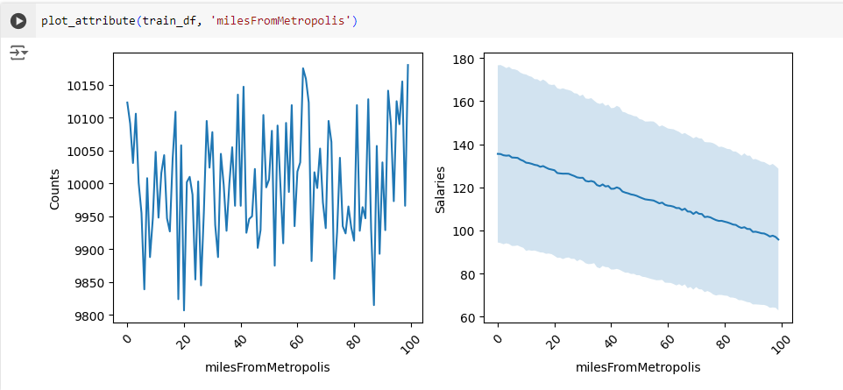
As you live far from metro cities, your salary goes down.

Slide 16
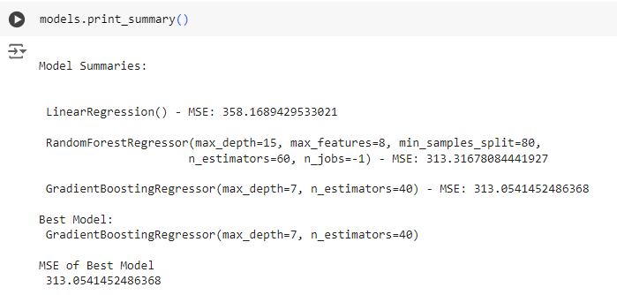
Model summary

Slide 17
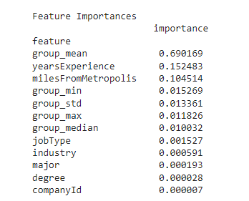
Feature importances

Slide 18
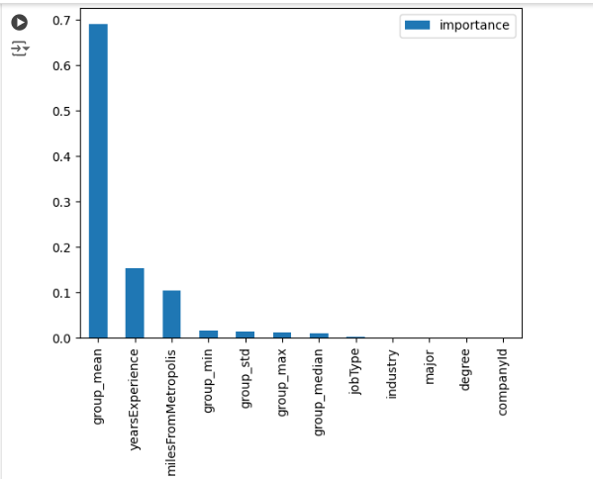
Feature importances plot

